Slide 1
The structure of the “lectures“
Klaus Wälde
Gutenberg University Mainz
www.waelde.com

Slide 2
Learning with and from experts
By courtesy of Gary Colet
https://www.linkedin.com/in/garycolet

Slide 3
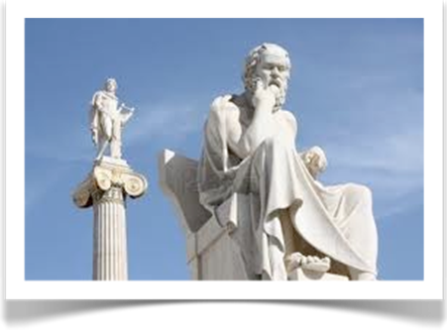
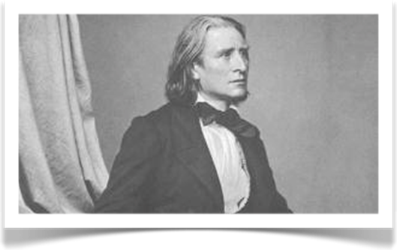
Learning with and from experts
Socrates, Greek philosopher
470BC - 399BC
philosophical discourse vs. rhetoric
(in Plato’s Gorgias)
Franz Liszt, Hungarian composer
1811 – 1886
teaching Master Classes letting
students discuss first
Notes:
See last slide on notes

Slide 4
The structure of the “lectures”
1. Fix the learning objectives
2. Illustration of approach for a first case study by the expert
3. Students go through another case study
5. Some traditional lecture style (to complete an issue)
4. The expert view, contrasted with the students‘ views on the second case study

