Slide 1


Economic Methods in QDEM
Klaus Wälde
Winterterm 2023/24
https://www.macro.economics.uni-mainz.de/qdem-maths23-24/
Prof. Dr. Klaus Wälde
Chair in Macroeconomics

Slide 2


MASTER‘S PROGRAM IN
QUANTITATIVE DECISION MAKING IN ECONOMICS & MANAGEMENT

Slide 3
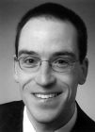
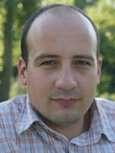
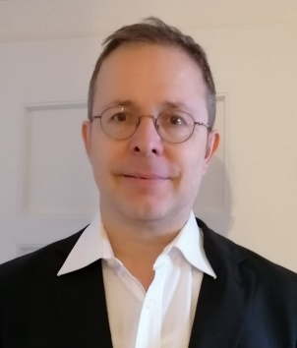
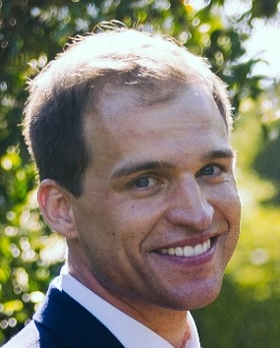
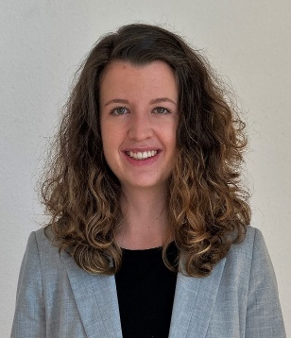
Heads of the program
Prof. Dr. Stefan Irnich
Dr. Constantin Weiser
Prof. Dr. Thorsten Schank
Prof. Dr. Florian Hett
Daniela Maier, M.Sc.

Slide 4
Introductory course on mathematical methods in economics
Objective: prepare mathematical background for other courses
  Lagrange function
  Shadow prices
  Envelope theorem
  Difference equations without and with uncertainty
Method
  applied – no abstract maths
  dynamic framework – overlapping generations model
  Textbook “Applied Intertemporal Optimization”
Prof. Dr. Klaus Wälde
Chair in Macroeconomics

Slide 5
The plan (time wise)
I teach – you teach
you problem sets
(form groups now)
Prof. Dr. Klaus Wälde
Chair in Macroeconomics

Slide 6
The plan (references)
Textbook “Applied Intertemporal Optimization” (Ch. 2, 3.2, 7 and 8.1) plus research-in-class
https://www.macro.economics.uni-mainz.de/klaus-waelde/waelde-klaus-applied-intertemporal-optimization/
https://www.waelde.com/pdf/AIO.pdf (direct download)
Prof. Dr. Klaus Wälde
Chair in Macroeconomics

Slide 7
The plan (contents - see also pdf)
12 units, split between I teach, you teach and tutorials according to progress
Chapters and exercises
  Chapter 2
  Exercises 1-4, 9, 10 (exercises are solved by student groups)
  Exercise on positive and negative technology shocks (cmp. 11.8.5 „Der Effekt von positiven und negativen Technologieschocks“ from Macro I)
  Chapter 3.2
  Excercise 1
Prof. Dr. Klaus Wälde
Chair in Macroeconomics

Slide 8
The plan (contents continued)
Chapters and exercises
  Chapter 7
  Exercise „from exponential (age) to Pareto (wealth) distribution“
  Chapter 8
  Exercise 4 and 6
  Joint teaching „we develop a 2-period OLG model with stochastic death in class“
Prof. Dr. Klaus Wälde
Chair in Macroeconomics

Slide 9
The plan (method)
traditional
paper and pencil
Prof. Dr. Klaus Wälde
Chair in Macroeconomics

Slide 10
Let‘s start …
Prof. Dr. Klaus Wälde
Chair in Macroeconomics

